Slide 1
  Call Management Configurations
LEVEL - PRACTITIONER

Slide 2
About the Author
Created By: | Sourav Bhattacharjee, Saibal Roy, Supriyo Saha
Credential Information: | Associate – Projects; Sr. Consultant CRM – EAS Salesforce
Version and Date: | V0.1: 18-Jan-2018, V0.2: August-2023: Updated with Lightning UI
Modified By: | Abhijan Majumdar

Slide 3
Recap ...
In the previous Module - Product Metrics Configurations, you learnt to:
  Define Product Metrics
  Define different types of Metric fields
  Configure Product Metrics section on Account profile
  Create a new Product Metrics
  Create Metric Configuration
  Explain how users can control Metric on Account Profile
And now ...

Slide 4

Objectives
After completing this chapter, you will learn to:
  Describe Call Data Model
  Review Marker Fields and Section Signals
  Define call page layout sections including:
      Call Attendees
      Product Details
      Key Messages
      Pre and Post Call Notes
  Configure call page layout assignment
  Review Restrict and default Call types by Account record types

Slide 5

Do You Know
Section Signals:
  Section signals are strings appended to the end of a Section Name on a page layout
  These section signals communicate configuration instructions that are carried out by custom VEEVA pages both online and offline
Call object stores the main header information. Related objects store call Detail, Expenses, Discussions, Key Messages, Samples and Promotional, Attendees information
Special VEEVA CRM Marker Fields are needed for specific functionality in call details:
  Call Attendees
  Products Detailed
  Key Messages

Slide 6

Overview
Introduction:
  The Call Reporting module allows users to capture every aspect of their interactions with HCPs
  With dozens of configuration options, Call Reporting can be tailored to specific business needs by user profile

Slide 7
Call Data Model

Slide 8
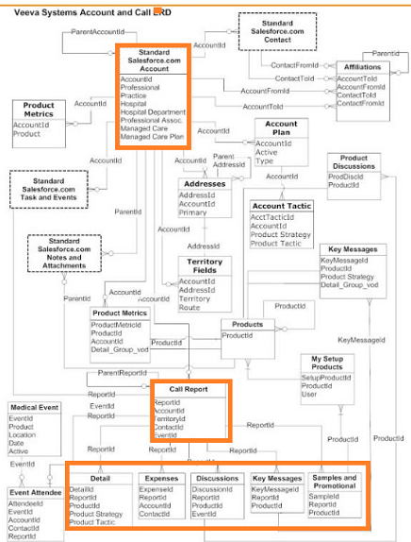
Call Data Model ... 1
  Calls and Accounts are the center of the VEEVA data model
  Call Report object stores all the main call header information
    Lookup relationship to Account object
    Related objects are Detail, Expenses, Discussions, Key Messages,
    Samples and Promotional, Attendees

Slide 9
Call Data Model ... 2
Object | Key Feature
Call Report (Call2_vod__c) | This object stores the main call header information including account, address, call date time information. There is one call row for every account or contact on the call. A group call with 3 doctors will produce 4 call rows.
Call Detail (Call2_Detail_vod__c) | This object stores all product details data recorded on any call. Product used in call and their order in which the detail was delivered is stored here.
Call Discussion (Call2_Discussion_vod__c) | This object stores all product discussions data recorded on any call
Call Expense (Call2_Expense_vod__c) | This object stores all expense data recorded on a call
Call Key Message (Call2_Key_Message_vod__c) | This object stores all Key Messages recorded on a call. This also stores the CLM presentation details used in call
Call Sample (Call2_Sample_vod__c) | Samples and Promotional Items itemized on Call Reports

Slide 10
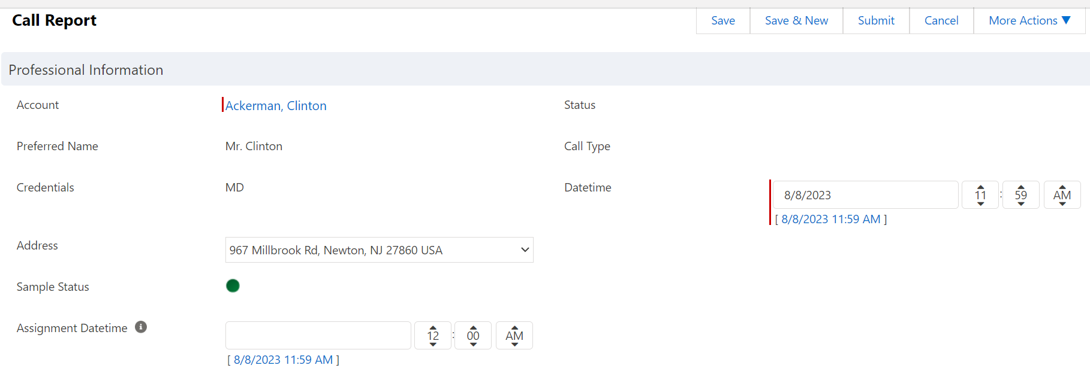
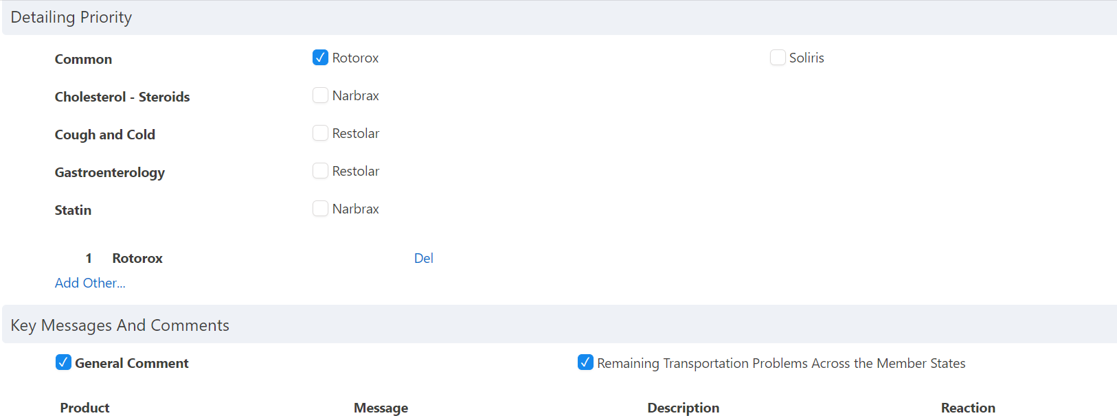
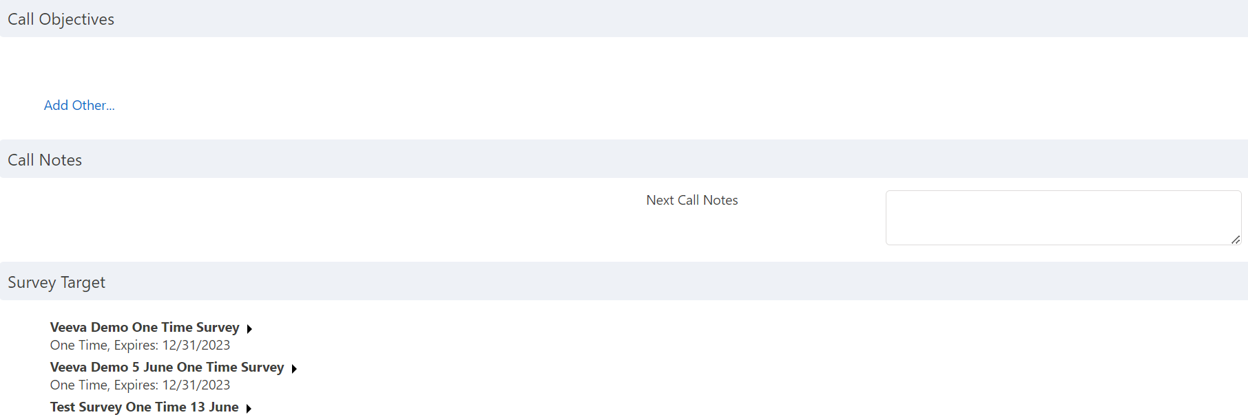
Call Reporting Functionality
  The below snapshot describes which section in call page is stored in which object.
Account Information
Call Report Details
Products Detailed
Key Messages
Call Objectives
Call Notes
Survey Target

Slide 11
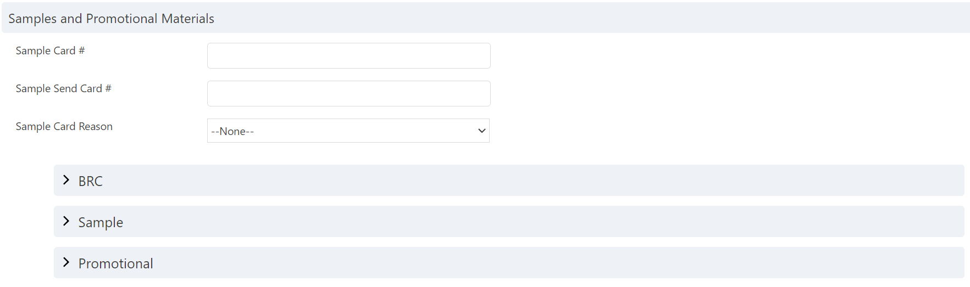
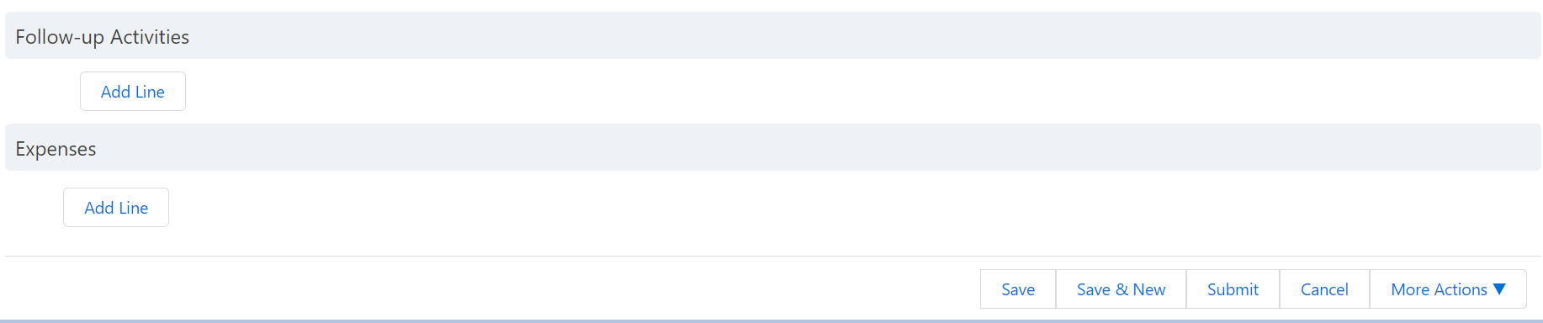
Call Reporting Functionality (continued)
  The below snapshot describes which section in call page is stored in which object.
Samples & Promotional Materials
Follow-up Activities
Call Expenses

Slide 12
Call Report Configuration Overview
Customize any Call Page Layout
Create your own Call Report Record Types and corresponding Page Layouts
Every call page layout is composed of a set of sections and standard or custom fields
Special VEEVA CRM Marker Fields for specific functionality:
  Call Attendees
  Products Detailed
  Key Messages

Slide 13
Marker Fields and
Section Signals

Slide 14
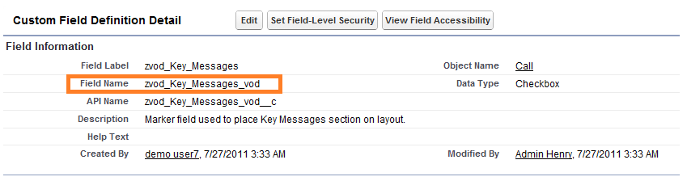
Marker Fields
Contain special code that renders a custom piece of user interface
  Stores no data, only add functionality to page layouts
Mainly used on layouts for Call Reporting, Medical Inquiries, and other objects
Denoted with the prefix “zvod_” and the suffix “_vod”
For Call Management, add the following marker fields to page layout(s):
  zvod_Account_Primary_Parent_vod__c
  zvod_Account_Account_Identifier_vod__c
Don’t:
Delete Marker Fields
Edit the name or data type fields
Admin can only:
Add or remove Marker fields from page layouts

Slide 15
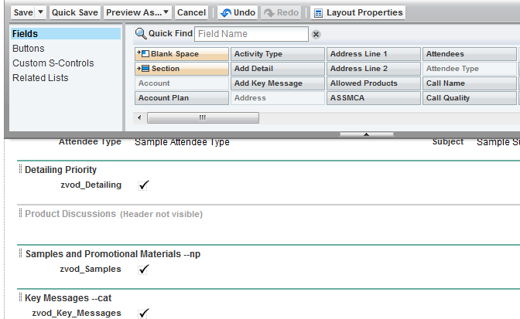
Call Page Layout Configuration
Identify the call page layout to be modified
To edit a call page layout:
  Setup > Create > Objects > Call > Page Layouts section
  Click the Edit link for the desired page layout
Create 1-column sections.
Place Marker fields in their respective section
Use Section Signals to change the behavior of the Marker field

Slide 16
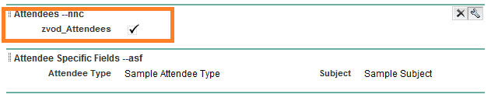
Section Signals ... 1
Used to configure the behavior of Marker Fields:
  Used primarily on the Call and Medical Inquiries page layouts
  Each call page layout section has its own set of section signals
Denoted by “--”:
  Example: --nnc to hide the New Contact button in Attendees
  For a complete list of section signals, see VEEVA CRM Admin Guide
  Can include multiple Section Signals in a single section property
  Not displayed to users

Slide 17
Section Signals ... 2
Attendees Section
  --ao: Defines attendees as a non-required field
  --nnc: To hide the New Contact button
  --asf: Enables Attendee Specific Fields
  --atf: Filtered to display just those attendees that are targets for the user recording the call
  --st: Adds a Type column to the Attendees list on calls
  --su: Includes Users records when searching
  --paa: Displays the attendees section for individual calls

Slide 18
Section Signals ... 3
Promotional Items Section
  --ns: No sampling
  --np: No Promotional Items
  --gp: Disable deletion of CLM Call Key Messages on the Call
  --so: Enables the signature button regardless if samples are selected
  --pg: Displays samples and promotional items in collapsible groupings
  --ded: Disable deletion of CLM Call Key Messages on the Call
  --cat: Displays the category grouping and the vehicle field for each Key Message

Slide 19
Section Signals ... 4
Promotional Items Section
  --ra: Enables the Clear Selection button allowing the user to quickly clear all Sample and Promotional Item entries
  --nb: No BRC/Sample Request product catalog records display
  --no: No items of any other type (e.g. reprints) in the samples section
  --np: No promo items in the sample column
  --npdma: Non-PDMA sampling; does not enforce validation of signature date or sample cards
  --ns: No sample products and no lot #'s in the samples section
  --nsl: No Sample License

Slide 20
Section Signals ... 5
Detail Section
  --rd: To require a user to select a detail in order to submit a call
  --htp: Highlights detail products that exist as Cycle Plan Details in the current and active cycle plan
  --sd: Enables signed details
Samples Section
  --rd: To require a user to select a detail in order to submit a call
  --htp: Highlights detail products that exist as Cycle Plan Details in the current and active cycle plan
  --sd: Enables signed details
  --nhvp: No High Value Promotional Items product records are displayed
  -nslns: No Sampling license and no signature required

Slide 21
Section Signals ... 6
Account / Address Information Section
  --nab: Prevents the "<Add New Address>" option from displaying in the drop down list for Business (Group) Accounts
  --nap: Prevents the “<Add New Address>” option from displaying
  --nno: Disables the Submit button online when placed in the button section on a Call Report page
Note:
  Always Clear VEEVA Cache after configuring call page layouts with Marker fields and Section Signals

Slide 22
Call Page Layout
Sections

Slide 23
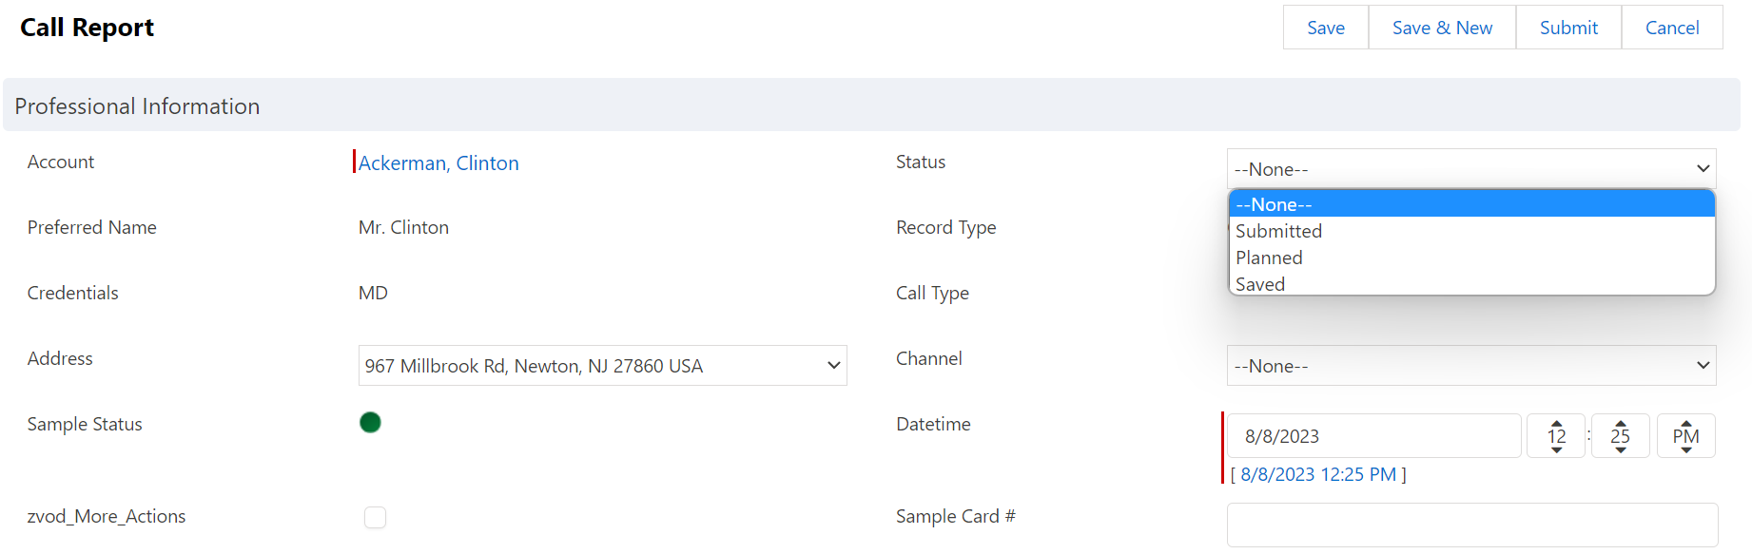
Call Status
Planned
  Call is scheduled using the My Schedule call Planned scheduler
Saved
  Set once the user has saved the call by clicking the Save button on the call report
Submitted
  Call is completed
  All fields are locked and cannot be edited
  Must be unlocked for further editing Submitted

Slide 24
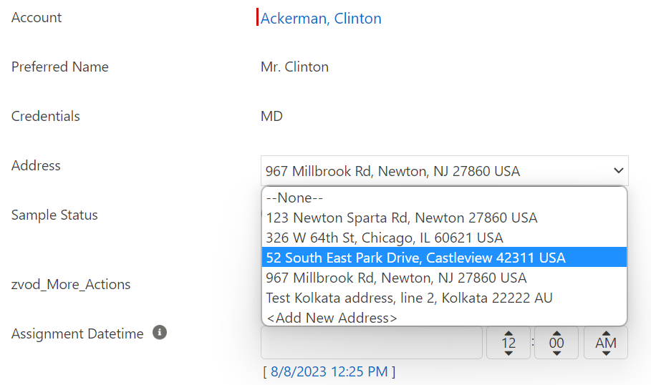
Call Address
Select address for the call from the address picklist
  Displays all active addresses for the selected account
  Selected address will be set as the Preferred Address in the user’s TSF record

Slide 25
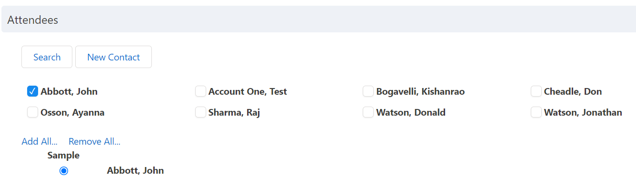
Group Call Attendees
A list of all person Accounts affiliated through the Sphere of Influence and/or the Account Hierarchy with the selected business Account are available as potential attendees
Search for other Accounts to add as attendees or create new Account

Slide 26
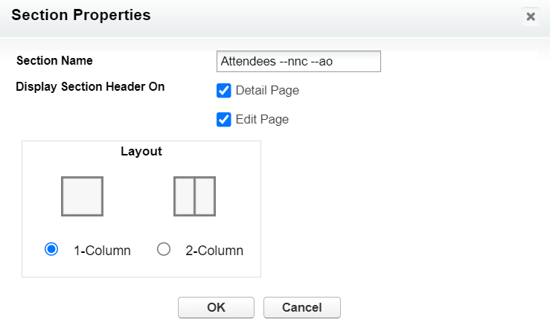
Call Report - Attendees
Separate call record is created for every attendee on the call.
  Call record for the business Account becomes the parent for each attendee call record
To display Attendees zvod_attendees marker field is needed on the Call Report page layout, under attendees section
Additional Section Signals:
  --ns = Hides sampling radio buttons and corresponding labels
  --ao = Makes attendees optional
  --nnc = Hides New Contact button
  --su = Displays User records when searching

Slide 27
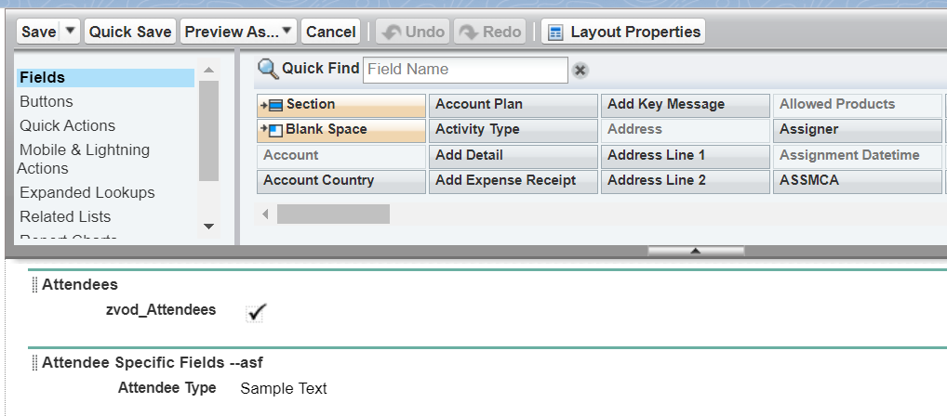
Attendee Specific Fields
VEEVA provides the ability to enter information specific to each attendee call record on a
group call
Admin need to create a section on the call page layout and with the --asf section signal
  Add attendee specific fields as needed in the same section
Renders section for each attendee

Slide 28
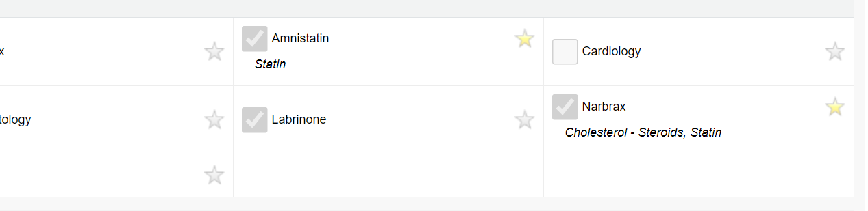
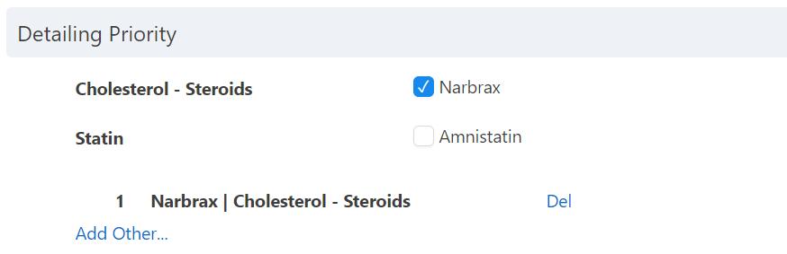
Product Details
Allows users to indicate which products were detailed and in what order
  User’s My Setup controls which detail products are available for selection
  The sequence of product details is determined by the order in which the user selects them. The user may also explicitly reorder the details using arrow buttons (online) or drag and drop (offline platforms).
Products inserted automatically create a corresponding line in the Product Discussions and Key Messages sections
Products marked as “Favorites” in My Setup will display by default under specified Detail Groups
Products into categories based on an understanding of the essential properties and relationships between them.
Products not in a Detail Group will be listed under Common.

Slide 29
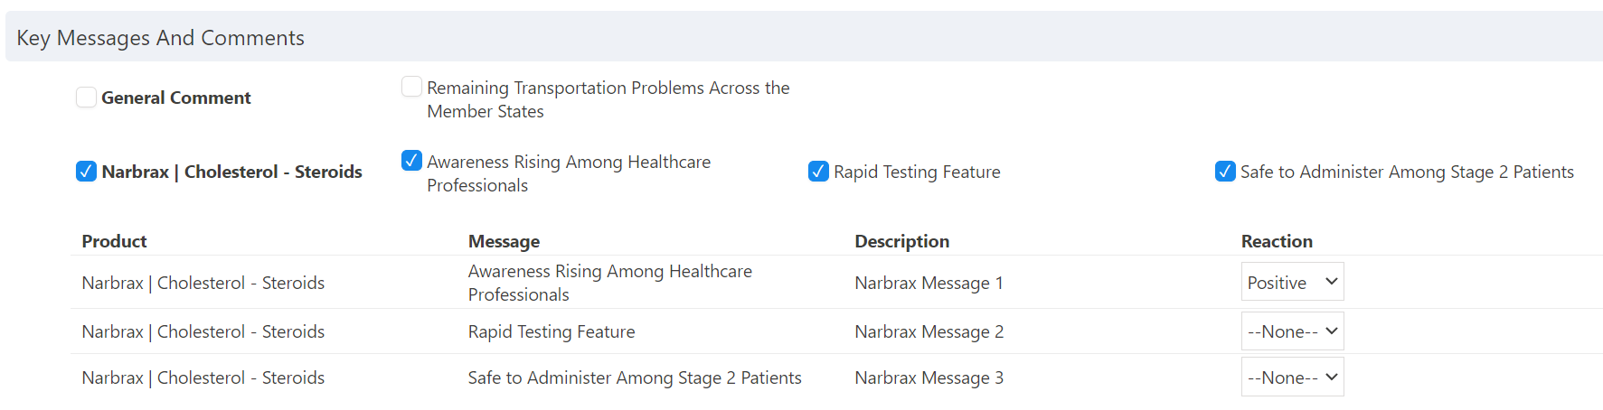
Key Messages Configuration
Branded marketing messages associated with product strategies and product tactics
Key messages are usually determined by Marketing team and approved by Legal
To enable Key Messages, place the zvod_key_messages marker field on the Call page
layout
Key Messages associated with each product detailed are automatically added to Call Report
General Key Messages not related to a product can be displayed
Hide the Reaction field by removing visibility to the field on the Call Key Message object via Field Level Security

Slide 30
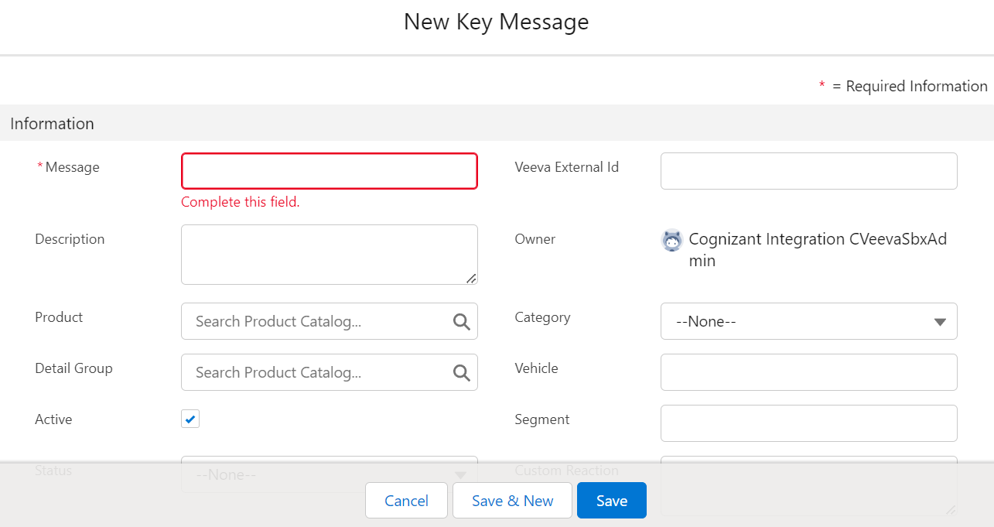
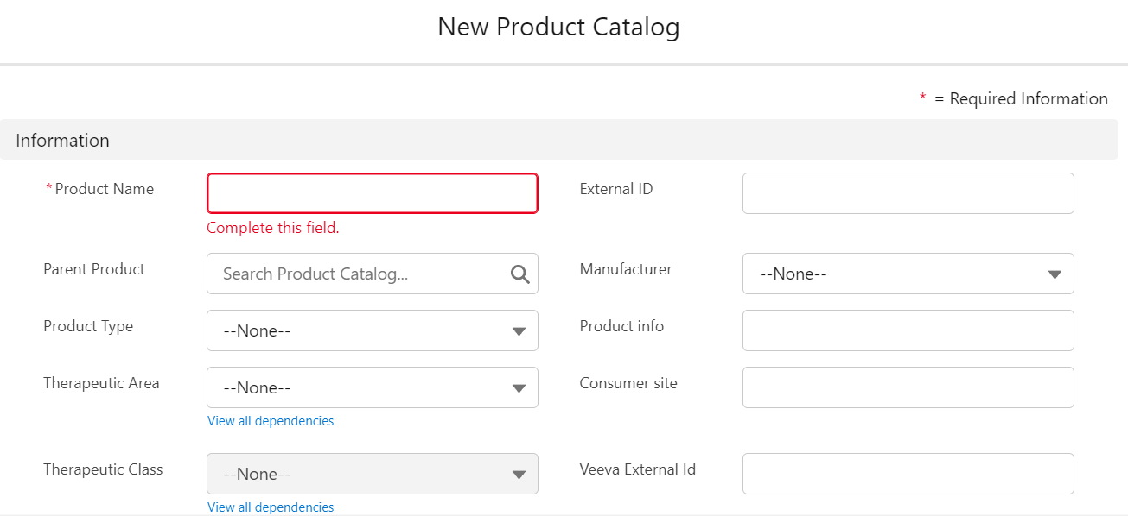
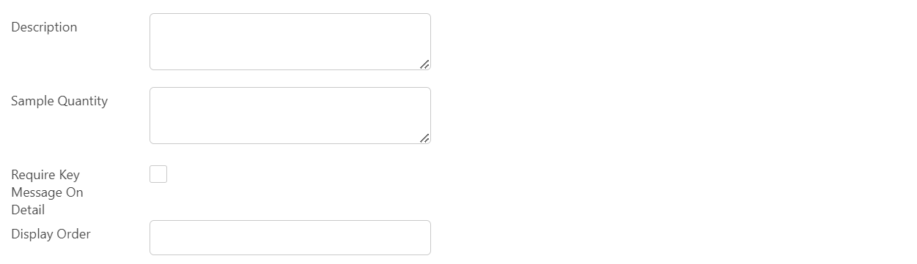
Key Messages
To create a new key message and associate with a product, go to:
All Tabs > Key Messages
Product Catalogs can be created from: All Tabs > Product Catalog
Go to Product Catalog to indicate whether a Key Message is required when a product is detailed via the Require Key Message On Detail checkbox.

Slide 31
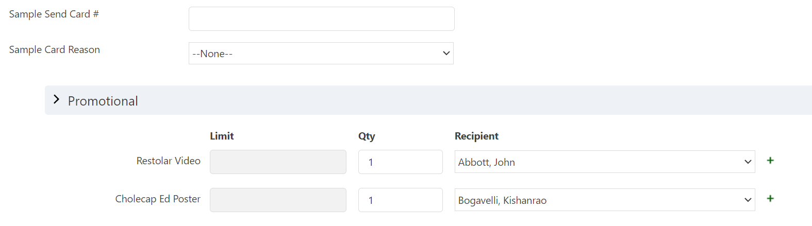
Sample and Promotional Items
Allow users to indicate which sample, BRC or Promotional item was provided to the
HCP during the interaction
Sample product name
Recipient HCP
Quantity of disbursement

Slide 32
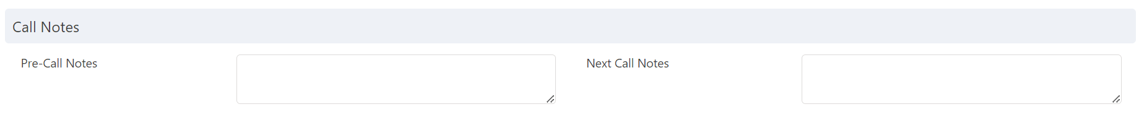
Pre-Call and Next Call Notes
Next Call Notes recorded on a call will automatically appear in the Pre-Call Notes section
for the next call.
  My Schedule also includes Pre-Call Notes functionality
Gives insight into the activities or action items that were recorded on the previous call
Use FLS to hide Pre Call Notes from the Call & My Schedule.
Remove Next Call Notes from the page layout to hide the field.

Slide 33
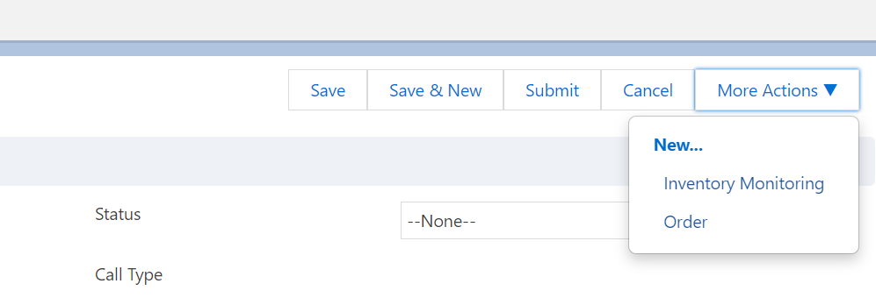
More Actions
A button and dropdown menu called More Actions can be added to the Call Report page
layout
Allow users to create a new Medical Inquiry, Order or Inventory Monitoring, and Send Approved Email directly from a Call Report

Slide 34
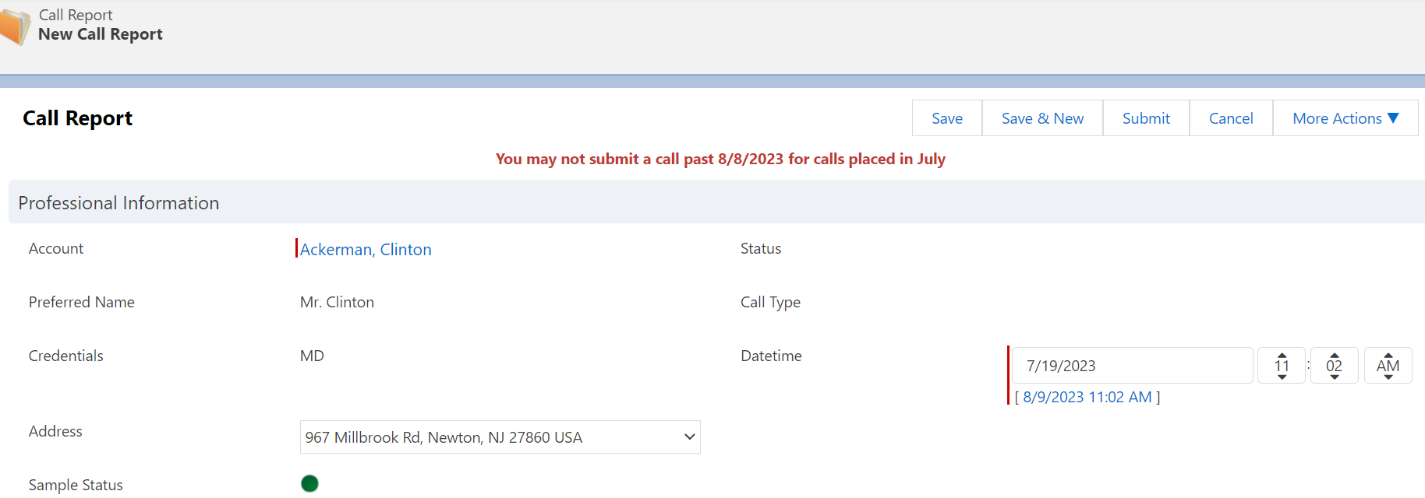
Call Submission Cut Off Date
Configure a cutoff date for call submission. Prevents users from submitting calls
recorded in the previous month after a set date in the current month
Configure the Call Submission Monthly Window VEEVA Message
Syntax: Month, Day;

Slide 35
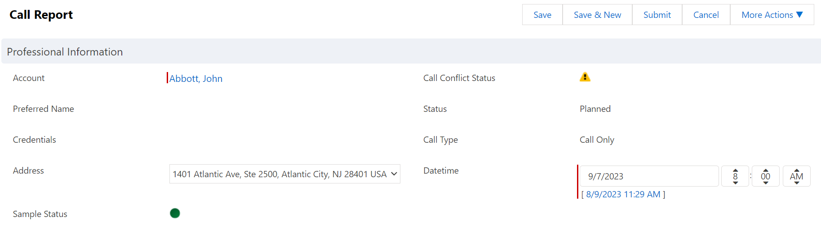
Call Conflict Warning
To avoid call planning conflicts, display a warning sign according to different call conflict
date thresholds
Helps identify calls on accounts for which other calls have already been scheduled within a
specified time period
Warning is visible on My Schedule and within a Call Report

Slide 36
Call Conflict Warning Configuration
Add the zvod_Call_Conflict_Status_vod field to the desired Call Report Page Layouts
Set the Call_ScheduleConflict_Threshold_vod VEEVA Setting to the desired value
Value must be between 0 and 3:
  0 = no conflict control
  1 = system checks if another call is present on the selected date
  2 = system checks if another call is present 1 day before or after the selected date
  3 = system checks if another call is present within 2 days before or after the selected date
This feature is supported on the online and offline platforms

Slide 37
  Configuration of Call
  Page Layout
  Assignment

Slide 38
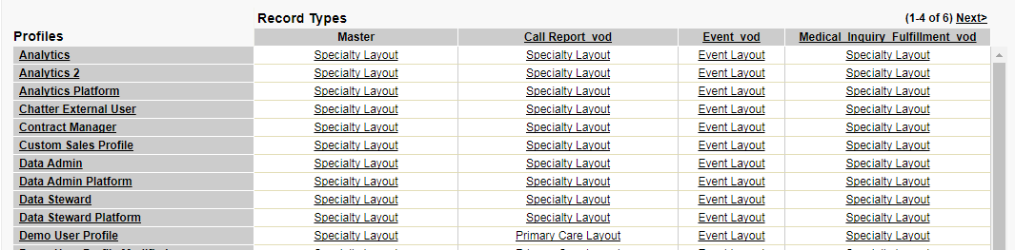
Call Record Page Layout
Assign call record page layouts using the page layout assignment matrix in the Call object:
  Setup > Create > Objects > Call > Page Layouts section and click the Page Layout Assignment
  button

Slide 39
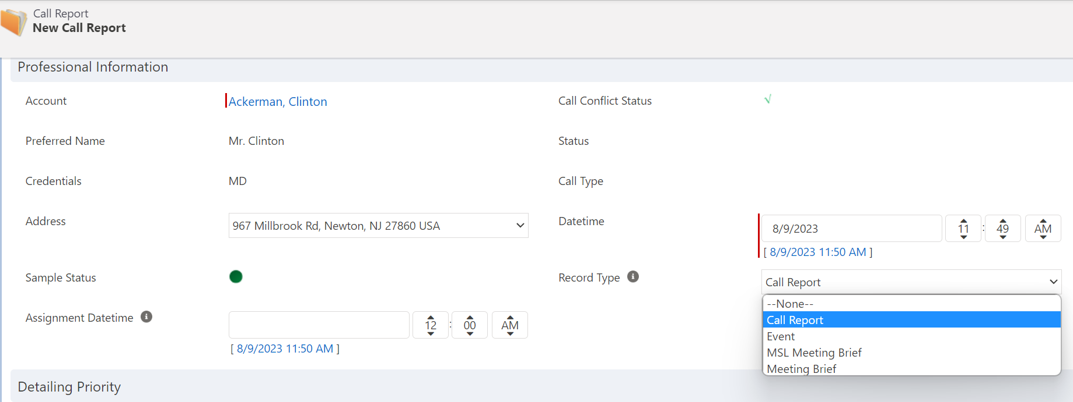
Call Record Type
A picklist can be displayed on the call page layout allowing the user to change the call
record type
  Add the Record Type field (default & custom values) to all call page layouts (default & custom layouts)

Slide 40
Default Call Record Type values
Below are the default Call Record types in VEEVA:
  Call_Report_vod- Used for Primary Care or Specialty sales representatives to record a Call with one
  or more HCPs, and typically includes product detailing and discussions, Key Messages, as well as
  samples and promotional items distributed
  Event_vod- Used to record a call related to a Medical Event that typically includes product detailing, discussions, and Key Messages
  MSL_Meeting_Brief_vod- Used to record an interaction between an HCP and a Medical Science Liaison that typically includes product detailing, discussions, and Key Messages
  Meeting_Brief_vod- Used for a Managed Markets representative to record meetings with payers and typically includes product details and discussions

Slide 41

New Call Buttons - Online
Record a Call button can be placed on specific pages online like Hospital, Hospital
Department, Professional, Medical Events
  Users should only be allowed to record a call from a single page rather than from multiple pages by
  removing the Record a Call button from pages
To set default call record type:
  Setup > Manage Users > Profile > [Profile] > Record Type Settings > Calls
Automatically creates the default Call Report record type for the user

Slide 42
  Review Restrict and
  default Call types by
  Account record types

Slide 43
Restricting Call Type by Account Type
Removing the ‘Record a Call’ button from Account pages only affects calls recorded online
  Record a Call menu still appears offline on iRep for all Account record types
Restrict the Call record types available when recording a call for specific Account record types both online and offline
  E.g. When recording a call for hospitals, only allow calls of type Call Report
  E.g. Prevent users from recording calls for Hospital Departments both online and offline VEEVA Only
ALLOWED_CALL_RECORD_TYPES
Use the this VEEVA Message/VEEVA Setting to configure – enter the account and call type labels
Hospital_vod,Call Report_vod;;
E.g. For Hospital Accounts, only allow calls of type Call Report
Hospital Department_vod;;
E.g. Prevent calls of any type from being recorded for Hospital Departments

Slide 44
Defaulting Call Type by Account Type
Default the Call record type based on the selected Account record type for the call
  Overrides the default record type defined in the user’s profile
DEFAULT_CALL_RECORD_TYPE
Use this VEEVA Message/VEEVA Setting to configure
Hospital_vod,Call Report_vod;;
Make Meeting Brief calls the default record type for Hospital calls

Slide 45
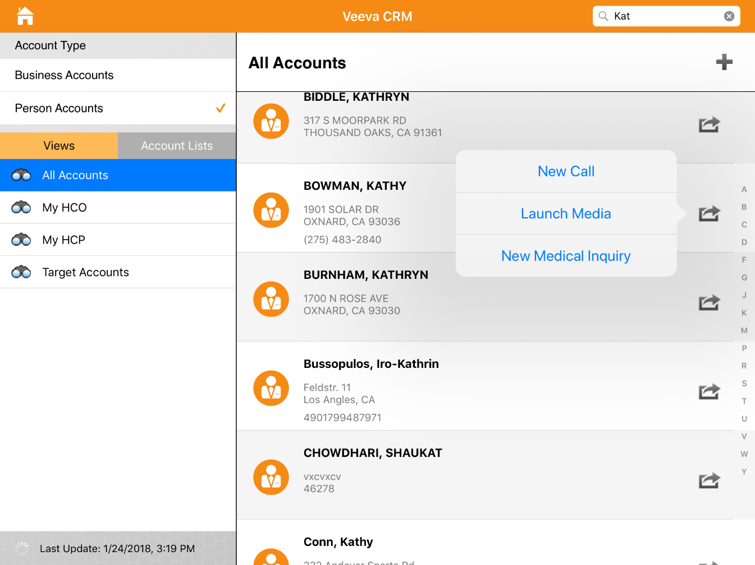
Call Reports on CRM (iRep)
On a call report, users can record products detailed and key messages, capture
signature for sampling, display media and capture customer reactions
Tap on the actions button on the account and then select New Call

Slide 46
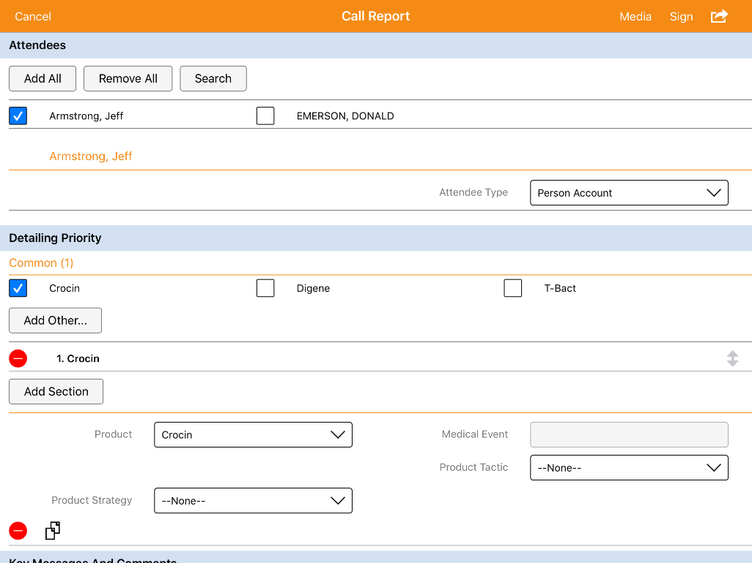
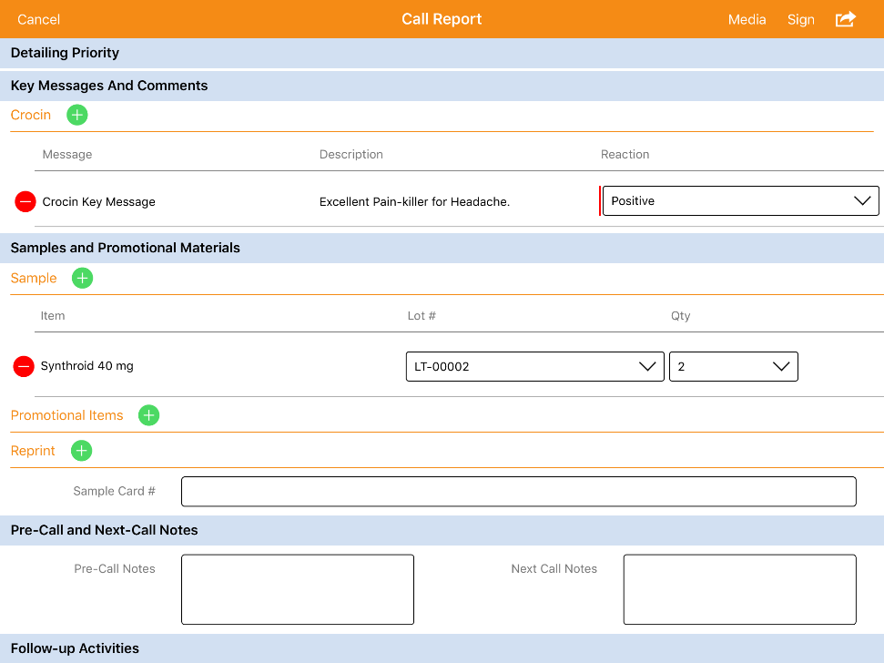
Call Reports - Products
Products marked as “Favorites” in My Setup will display by default under specified
Detail Groups
Products not in a Detail Group will be listed under Common

Slide 47
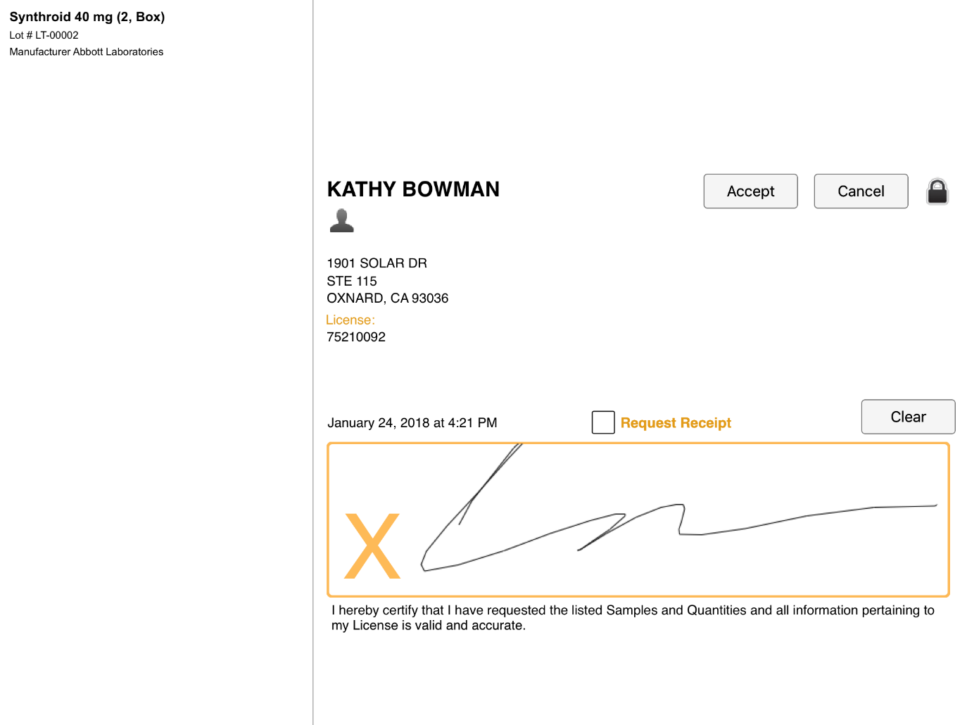
Call Reports - Signature Capture
Users can capture signature when dropping samples and/or while capturing consent
Click the Sign button on the call report to open the signature page
Disclaimer text can be displayed before signature
  Enable the Position_Disclaimer_Above_Signature_vod custom setting
Click ‘Accept’ after the signature is captured
Doctor signs for the sample
Disclaimer after
signature

Slide 48
  CLM Presentation

Slide 49
CLM Presentation ... 1
VEEVA's closed loop marketing module (CLM) puts rich media into sales team’s hands so they can
engage with physicians and key opinion leaders using the most compelling visuals available
CLM allows marketing materials to be displayed from the same application that sales reps are already
familiar with to record calls
This marketing material showcases the important information that sales reps want to convey to their targets as such, integration with the accounts and schedule of the sales rep is seamless
As content is viewed, Key Message information, duration of viewing, and additional customer defined clickstreams are tracked to provide valuable statistics so marketers can gain insight into their targets, and the content can be continuously improved for maximum effectiveness
VEEVA CLM also streamlines the process for managing and distributing the digital content to end users, ensuring they have access to the most current and relevant information on their device.

Slide 50
CLM Presentation ... 2
CLM consists of 3 main objects:
  CLM_Presentation_vod_c
  CLM_Presentation_Slide_vod_c
  Key_Message_vod_c
Each piece of content is associated to a Key Message record
Content is uploaded in industry standard formats and can include images, pdfs, videos, and HTML presentations
Multiple Key Messages are grouped together using CLM Presentation Slide records to link them to a CLM Presentation. Content files are downloaded to users’ devices during sync

Slide 51
CLM Data Model
Within VEEVA, content metadata is stored in three objects:
  CLM_Presentation_vod__c
  CLM_Presentation_Slide_vod__C
  Key_Message_vod__c
Each piece of media loaded into VEEVA CRM is represented as a Key Message, which describes information
about that file, such as the media file name, file size, the description that should be displayed to a user when they view a thumbnail of that file, and the associated product.
The following table outlines the required Key Message fields for managing content:
As with the standard Key Messages, users have access to CLM Key Messages based on their My Setup Products configuration. More granular access can be given by utilizing Salesforce sharing rules
Field | Description
Media_File_Name_vod__c | External ID for the media file. The ID is automatically populated when a media file is added (via Vault integration, FTP, or upload link). If managing CLM without the Vault integration, the ID provides the ability to easily update a piece of media by uploading content with the same unique external ID
Media_File_CRC_vod__c | Automatically populated when media file is added
Slide_Version_vod__c | Used to manage the media file version
Media_File_Size_vod__c | Automatically populated when media file is added

Slide 52
Check Your Understanding ... 1
1. The Duration_vod field displays on the Call page only for Calls scheduled in My Schedule. If the Call originated elsewhere, Duration_vod does not display.
State True or False
True
False
Answer: True
© Cognizant 2023

Slide 53
Check Your Understanding ... 2
2. Product Detailing is stored in the _____ custom object.
Call2_Detail_vod
Call_Detail_vod
Call2_Detail
Cal2_Detail
Answer: Call2_Detail_vod
© Cognizant 2023

Slide 54
Check Your Understanding ... 3
3. The call reporting module can also be easily configured to use with other components of VEEVA CRM such as Account Plans, Product Plans, Call Objectives, and Sample Limits.
State True or False
True
False
Answer: True
© Cognizant 2023

Slide 55
Check Your Understanding ... 4
4. What are the call status VEEVA provides?
Planned
Saved
Submitted
All of the above
Answer: All of the above
© Cognizant 2023

Slide 56
Check Your Understanding ... 5
5. Call attendees gets stored in which VEEVA object?
Call2_Attendee_vod
Call2_vod
Call2_Detail_vod
Call2_Discussion_vod
Answer: Call2_vod
© Cognizant 2023

Slide 57

Summary
In this module, you have learnt to:
  Describe Call Data Model
  Define Marker Fields and Section Signals
  Define call page layout sections including:
    Call Attendees
    Call Discussion
    Key Messages
    Pre and Post Call Notes
    Configured call page layout assignment
    Restrict and default Call types by Account record types

Slide 58

Source
https://crmhelp.VEEVA.com/doc/Content/Home.htm
Disclaimer: Parts of the content of this course is based on the materials available from the Web sites and books listed above. The materials that can be accessed from linked sites are not maintained by Cognizant Academy and we are not responsible for the contents thereof. All trademarks, service marks, and trade names in this course are the marks of the respective owner(s).

Slide 59
Coming Next ...
In the upcoming module - Cycle Plan Configuration, you will learn to:
  Describe VEEVA Cycle Plan
  Explain Cycle Plan in application
  Describe Cycle Plan Target Statistics Columns
  Describe Cycle Plan data model
  Configure Cycle Plan layouts
  Configure user profiles for Cycle Plans
  Configure Cycle Plans batch and real-time calculation processes
© Cognizant 2023

Slide 60
Thank you
  You have successfully completed
  Call Management Configurations

